Slide 1
Note Cards

Slide 2
Front of Card
Back of Card
Name the notes on the lines of the treble clef.
EGBDF

Slide 3
Front of Card
Back of Card
Name the notes on the spaces of the treble clef.
FACE

Slide 4
Front of Card
Back of Card
Name the notes on the lines of the bass clef.
GBDFA

Slide 5
Front of Card
Back of Card
Name the notes on the spaces of the bass clef.
ACEG

Slide 6
Front of Card
Back of Card
Treble Clef – high instruments
&

Slide 7
Front of Card
Back of Card
?
Bass Clef –
low instruments

Slide 8
Front of Card
Back of Card
Staff –
5 lines and 4 spaces where the notes are placed
========

Slide 9
Front of Card
Back of Card
Measure or Bar
A bite size chunk of music
\
===
\

Slide 10
Front of Card
Back of Card
Barline
Divides a staff into measures
\
===
\

Slide 11
Front of Card
Back of Card
Grand Staff
Both the treble and bass clefs connected with a bracket.

Slide 12
Front of Card
Back of Card
Bracket
Connects the treble and bass clefs to form the grand staff.

Slide 13
Front of Card
Back of Card
Melody
Rhythm
Form
Texture/ Harmony
Tempo
Timbre
Dynamice
Articulation
Name the 8 elements of music.

Slide 14
Front of Card
Back of Card
One note at a time/ the part of the song you go home singing
What is melody?

Slide 15
Front of Card
Back of Card
A pattern of sounds and silences within a beat
What is Rhythm?

Slide 16
Front of Card
Back of Card
How a song is organized including repeated material and development sections. Some examples are:
Theme and Variations
Sonata Form
Rhondo Form
The Blues
AABA
Verse/chorus
What is form?

Slide 17
Front of Card
Back of Card
More than one note at a time. Examples are:
Monophonic
Polyphonic
Homophony
What is Texture/ Harmony?

Slide 18
Front of Card
Back of Card
The speed of the music
What is tempo?

Slide 19
Front of Card
Back of Card
The color of the sound.
What makes a trumpet sound like a trumpet and not a flute.
What is timbre?

Slide 20
Front of Card
Back of Card
Volume
Soft and loud
What are dynamics?

Slide 21
Front of Card
Back of Card
The start of the note. The basic articulations are: accent; staccato; tenuto; marcato
*With wind instruments it involves your tongue. *In singing it is how you enunciate your words (we call this diction.)
*With percussion instruments it is how you strike the instrument
What are articulations?

Slide 22
Front of Card
Back of Card
Can be found at the beginning of a song. Top number tells us how many beats are in a measure/ bottom number tells you what kind of note gets a beat. Some common time signatures are:
Time signature
4 2 3 6
4 4 4 8
C c

Slide 23
Front of Card
Back of Card
Can be found at the beginning of a song. Indicates which notes are sharp or flat in a song. Every scale has its own key signature. This tells us where the home tone is, where Do is.
Key signature

Slide 24
Front of Card
Back of Card
#
Sharp
Raises a note by a half step and remains in effect for the entire measure.

Slide 25
Front of Card
Back of Card
Flat
Lowers a note by a half step and remains in effect for the entire measure.
b

Slide 26
Front of Card
Back of Card
Natural Sign
Cancels a flat or sharp and remains in effect for the entire measure.
n

Slide 27
Front of Card
Back of Card
The distance between any two notes.
Interval

Slide 28
Front of Card
Back of Card
Smallest interval in western music. Any two notes that are next to each other.
Half Step

Slide 29
Front of Card
Back of Card
Second smallest interval in western music. A whole step is equal to two half steps.
Whole Step

Slide 30
Front of Card
Back of Card
w
Whole note
4 beats
(in time.)
4
4

Slide 31
Front of Card
Back of Card
Half note
2 beats
(in time.)
h
4
4

Slide 32
Front of Card
Back of Card
Dotted half note
3 beats
(in time.)
h.
4
4

Slide 33
Front of Card
Back of Card
Quarter note
1 beat
(in time.)
q
4
4

Slide 34
Front of Card
Back of Card
Eighth note
1/2 beat
(in time.)
e
4
4

Slide 35
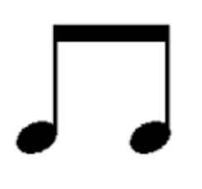
Front of Card
Back of Card
Two eighth notes.
½ beat each.

Slide 36
Front of Card
Back of Card
Sixteenth note
1/4 beat
(in time.)
x
4
4

Slide 37
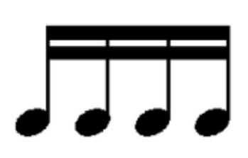
Front of Card
Back of Card
4 sixteenth notes
¼ beat each
(in time.)
4
4

Slide 38
Front of Card
Back of Card
Dot
A dot adds half of the value of the note being dotted to the note.
Q
.

Slide 39
Front of Card
Back of Card
Whole rest
4 beats of silence
(in time.)
4
4

Slide 40
Front of Card
Back of Card
Dotted whole rest
6 beats of silence
(in time.)
4
4

Slide 41
Front of Card
Back of Card
Half rest
2 beats of silence
(in time.)
4
4

Slide 42
Front of Card
Back of Card
Dotted half rest
3 beats of silence
(in time.)
4
4

Slide 43
Front of Card
Back of Card
Quarter rest
1 beat of silence
(in time.)
4
4

Slide 44
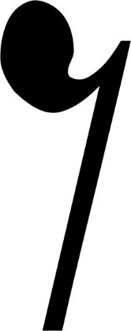
Front of Card
Back of Card
Eighth rest
1/2 beat of silence
(in time.)
4
4

Slide 45
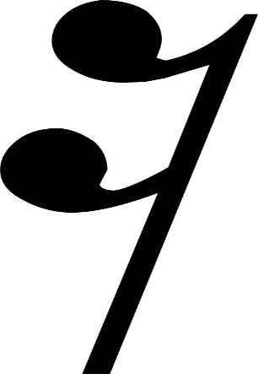
Front of Card
Back of Card
Sixteenth rest
¼ beat of silence
(in time.)
4
4

Slide 46
Front of Card
Back of Card
ff
Fortissimo
Italian word for very loud.

Slide 47
Front of Card
Back of Card
f
Forte
Italian word for loud

Slide 48
Front of Card
Back of Card
F
Mezzo Forte
Italian word for medium loud.

Slide 49
Front of Card
Back of Card
P
Mezzo Piano
Italian word for medium soft.

Slide 50
Front of Card
Back of Card
p
Piano
Italian word for soft

Slide 51
Front of Card
Back of Card
Pianissimo
Italian word for very soft
pp

Slide 52
Front of Card
Back of Card
Crescendo
Italian word for getting louder

Slide 53
Front of Card
Back of Card
Decrescendo
Italian word for getting softer

Slide 54
Front of Card
Back of Card
Q
Tenuto
long

Slide 55
Front of Card
Back of Card
.
Q
Staccato
Short

Slide 56
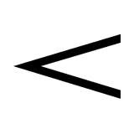
Front of Card
Back of Card
Accent
The note should be emphasized.
Q

Slide 57
Front of Card
Back of Card
v
Q
Marcato
Short and accented

Slide 58
Front of Card
Back of Card
Fermata
Hold the note longer than normal
u

Slide 59
Front of Card
Back of Card
Caesura
A pause or hold before going on.

Slide 60
Front of Card
Back of Card
,
Breath Mark
Indicates when to breathe.

Slide 61
Front of Card
Back of Card
Tie
Connects two or more notes of the same pitch.
q
q

Slide 62
Front of Card
Back of Card
q
Slur
Connects two or more notes that are different pitches.
q

Slide 63
Front of Card
Back of Card
A French word that means how your lips form around a mouthpiece
Emboucher

Slide 64
Front of Card
Back of Card
a series of notes differing in pitch according to a specific scheme (usually within an octave) scale
Scale

Slide 65
Front of Card
Back of Card
A series of whole steps and half steps.
W=whole step
H=half step
WWHWWWH
Major Scale

Slide 66
Front of Card
Back of Card
The same notes as a major scale but beginning on the 6th scale degree.
W=whole step
H=half step
WHWWHWW
Minor Scale

Slide 67
Front of Card
Back of Card
Three or more notes sounding at the same time.
Chord

Slide 68
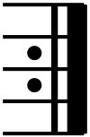
Front of Card
Back of Card
Repeat sign – go back to the beginning or a previous and play again.

Slide 69
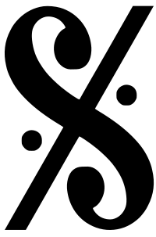
Front of Card
Back of Card
Da Segno – in Italian it mean the sign, abbreviated D.S. The term D.S. al Coda means to repeat back to this symbol.

Slide 70
Front of Card
Back of Card
Coda – In Italian it mean the tail end. This indicates the last section or end of a song.

Slide 71
Front of Card
Back of Card
How a musician measures time.
Beat

Slide 72
Front of Card
Back of Card
Able to withstand or recover quickly from difficult conditions. Able to endure. To push through an obstacle.
Resilient

